Slide 1

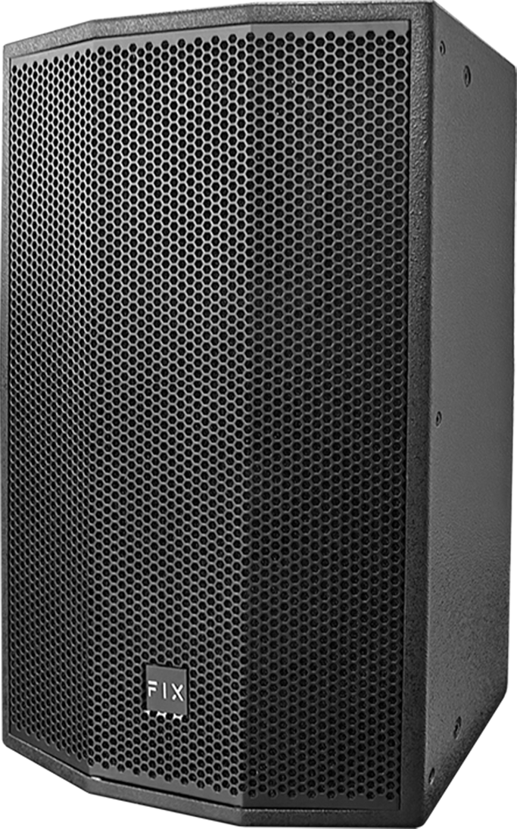

Full Range Speaker
DQ15
Professional Full Range Speaker System
FEATURE
25mm보이스코일 폴리에스터 트위터와 15인치 고효율 우퍼 탑재
AES 400W 최대 1600W의 출력을 제공
80x50도 회전이 가능한 비대칭혼 채택
SPECIFICATION
항목 | 세부내용
Type | Passive Fullrange Speaker
Frequency Response | 40Hz-19KHz
Sensitivity(1W@1m) | 98dB
Nominal Impedance | 8Ω
Rated power | 400 W AES with 1600W peak
LF Driver | 1 x 15"(385mm)/2.5" voice coil
HF Driver | 1 x 1 "(25mm)/1.4" voice coil
Coverage(H x V) | 80°×50°
Max.SPL | 121dB continuous, 127dB peak
Connectors | 2 x Speakon NL4
Size(WxDxH) | 450 x 450 x 721mm
Weight | 28.3kg
www.voatek.com
e-mail : voatek@naver.com
Tel : 031-8011-0388

