Slide 1

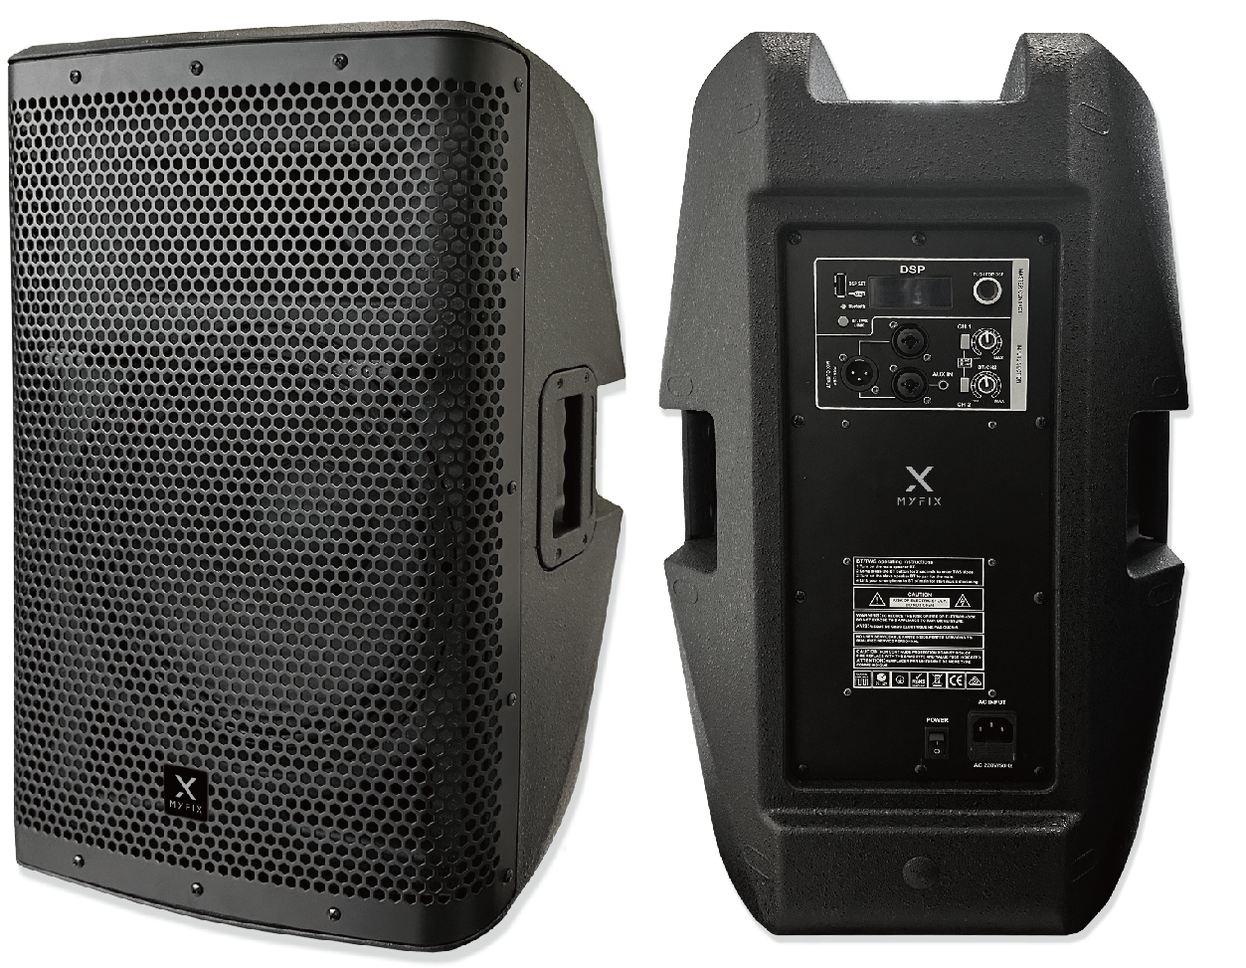

Active Bluetooth Speaker
FD-212A
Professional Active Bluetooth Speaker System
FEATURE
• 12” Active Bluetooth speaker
• 1.75인치 티타늄 트위터와 12인치(2.5” 보이스 코일) 우퍼 구성
• Bluetooth(TWS), DSP Control, AUX-IN 기능
• 다기능홀, 공연예술센터, 강당, 회의실에 적용가능
SPECIFICATION
항목 | 세부내용
Model | FD-212A
Including | 1 x 12" active subwoofer
Power | 400W LF + 100W HF
Frequency | 50 Hz – 20 kHz
Input | 2ch XLR & 1/4" Combo Input
Output | 1ch XLR Line Output
Max SPL | 124dB
Tweeter | 1.75" Titanium compression driver
Amplifier | Class D
Bass subwoofer | 1x12"(2.5"VC 50oz)
Nominal Impedance | 8 ohm
Function | Bluetooth, DSP Control, AUX-IN
Weight | 22.6kg
Dimension(W*H*D) | 370*600*335mm
www.voatek.com
e-mail : voatek@naver.com
Tel : 031-8011-0388

