Slide 1

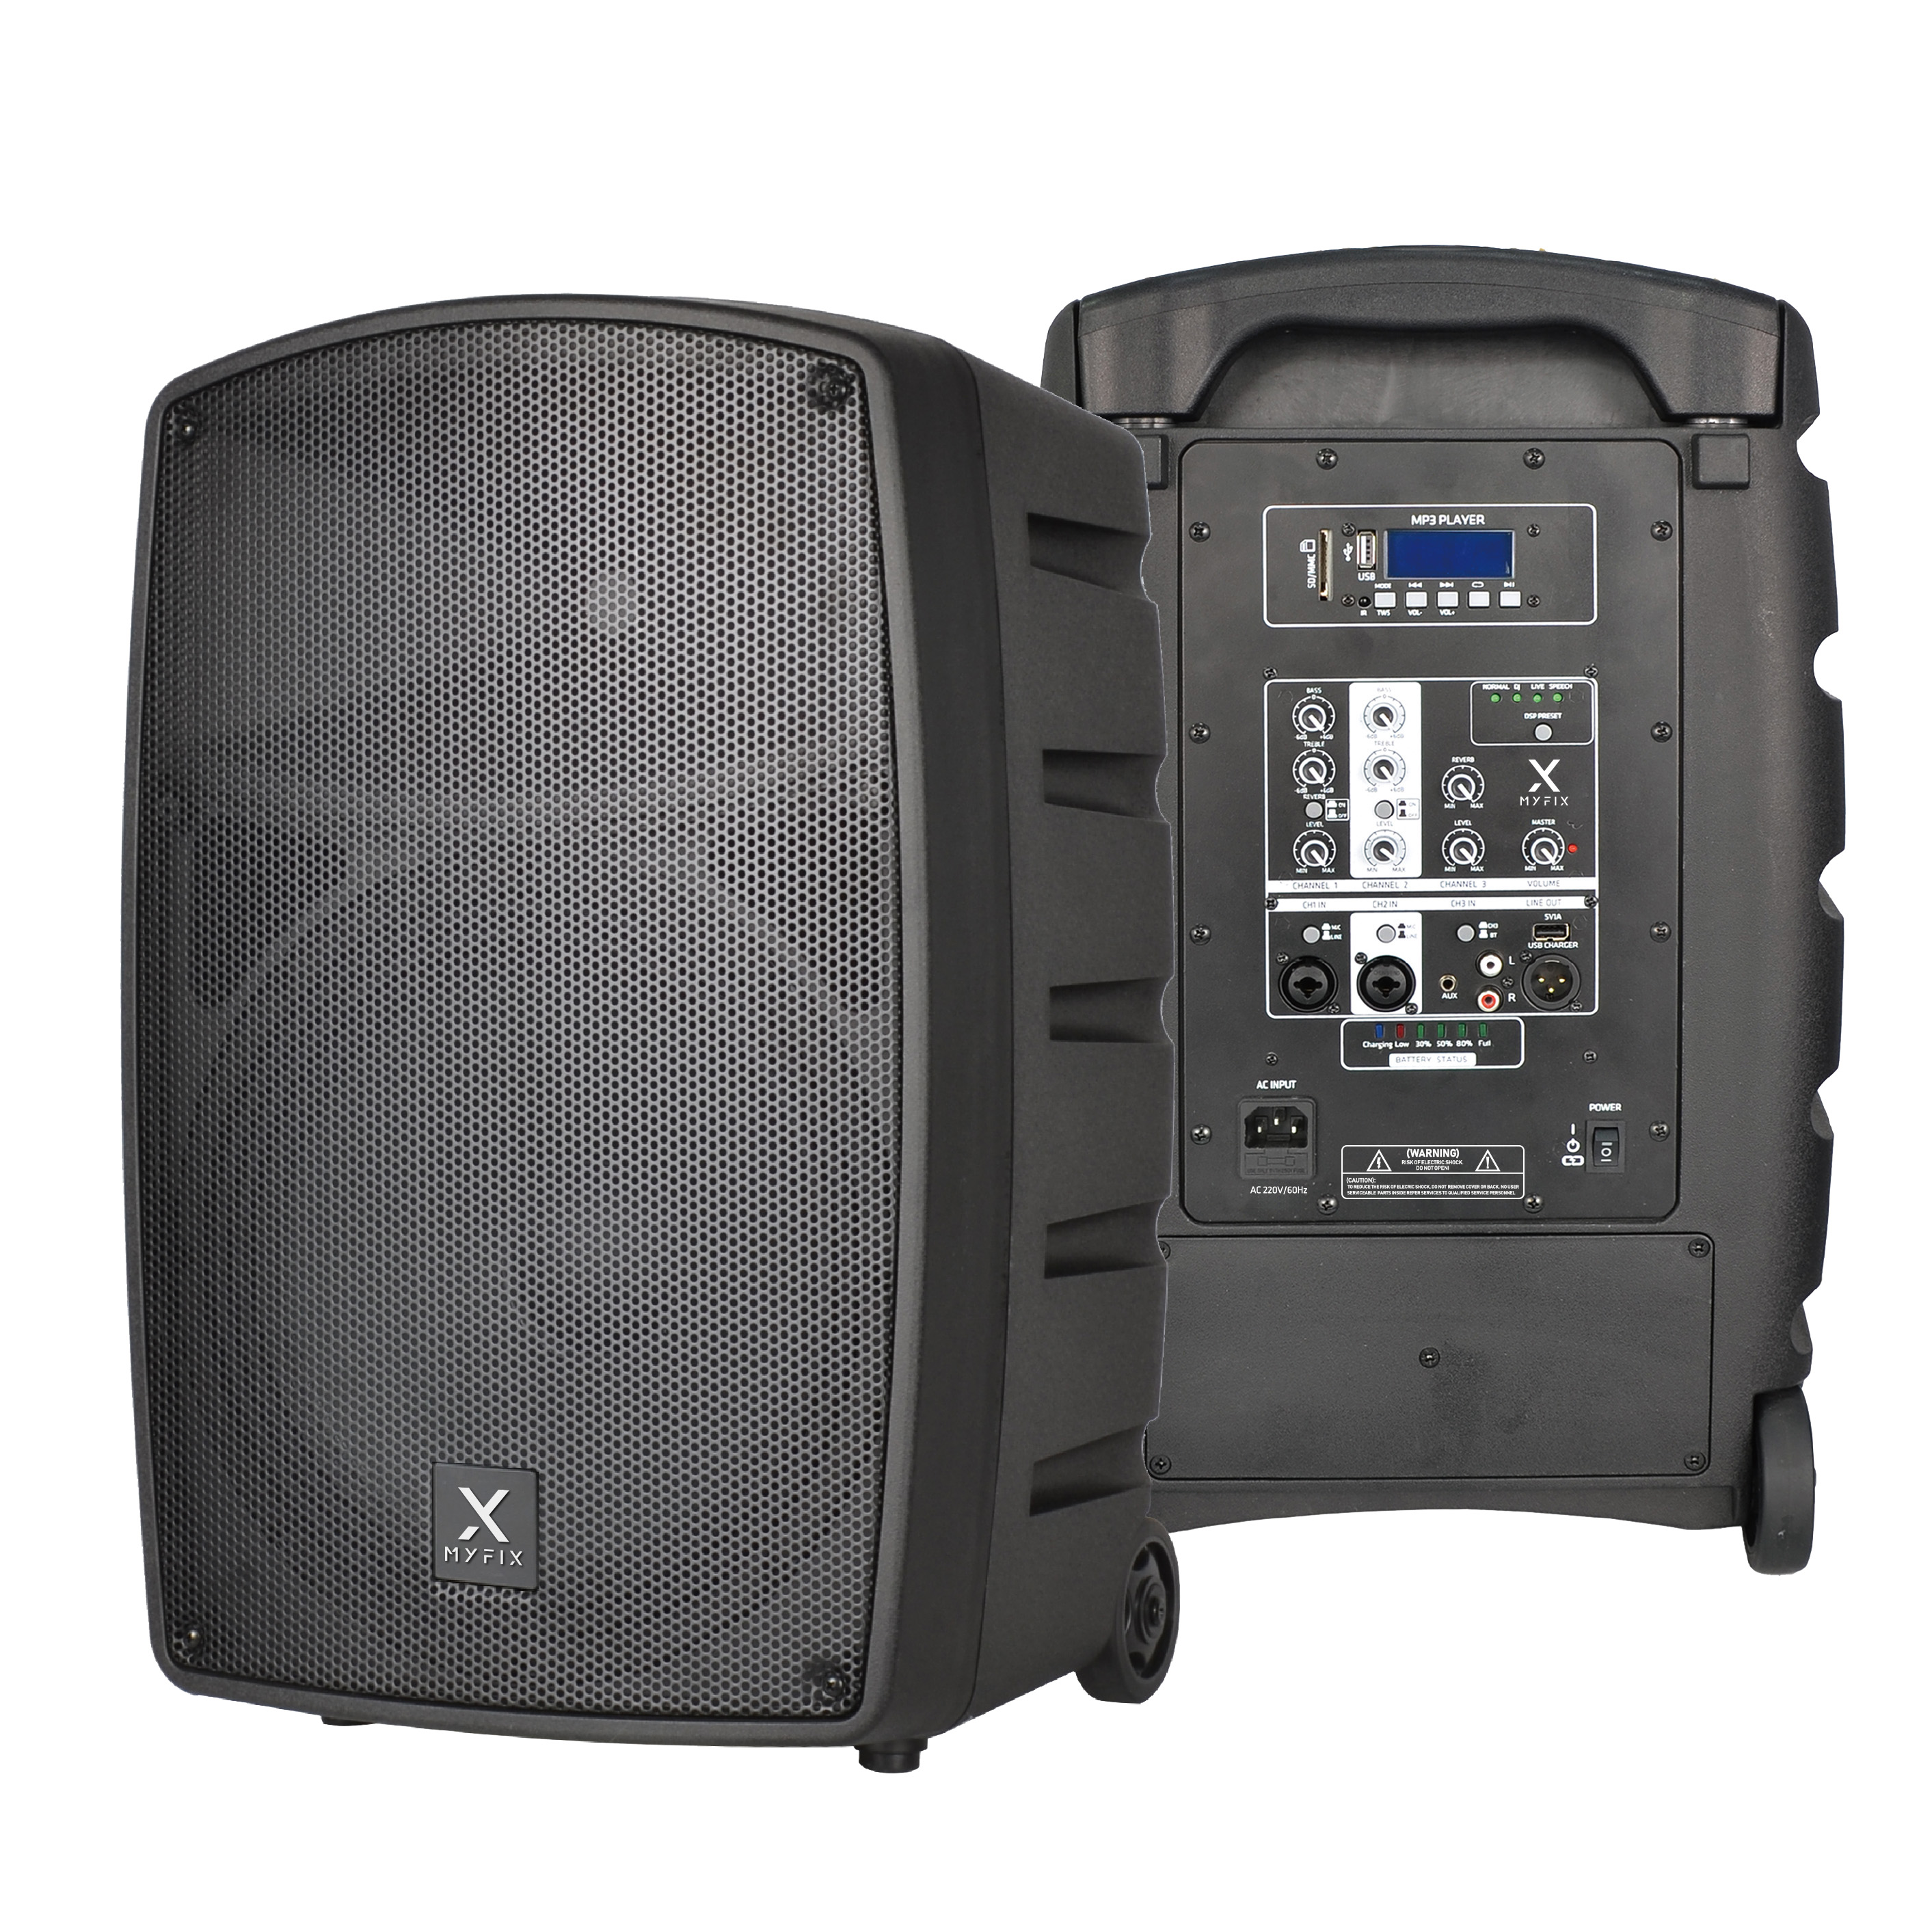

Active Bluetooth Speaker
FM-212A
Professional Active Bluetooth Speaker System
FEATURE
• 이동형 충전식 12” Active Bluetooth speaker
• 1인치 티타늄 트위터와 12인치”(1.5” 보이스 코일) 우퍼 구성
• Bluetooth(TWS), DSP Control, AUX-IN 기능
• 다기능홀, 공연예술센터, 강당, 회의실에 적용가능
SPECIFICATION
항목 | 세부내용
Speaker type | 12” Portable Battery Speaker
Frequency Range(-10dB) | 50Hz - 20KHz
Max.SPL | 122dB
Rechargeable battery | 12V 7000MA Lead acid, 12 hours battery life
HF Driver | 1" Polymer compression tweeter
LF Driver | 12” cone 1.5”VC 32OZ
Power amplifier output | 200W RMS. Class D Bi-amp with DSP(4modes) & MP3 Bluetooth 5.1 with TWS, 5V 1A USB charger for smartphone
System includes | 2*UHF Wireless Microphone, 1*AC Power cord
Connector | 3.5mm/RCA/XLR
Mic Input Level | <5mV
Line input/Output Level : | 250mV
Impedance | 4 Ohm
Sensitivity | 118dB Max SPL
Dimension(W*H*D) | 400*360*600mm
Weight | 14kg
www.voatek.com
e-mail : voatek@naver.com
Tel : 031-8011-0388

