Slide 1

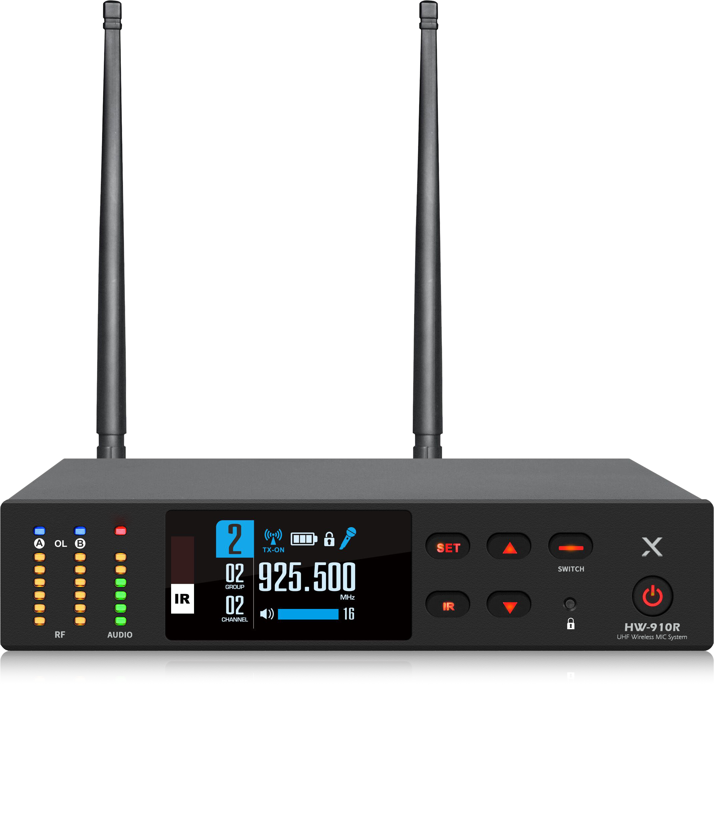

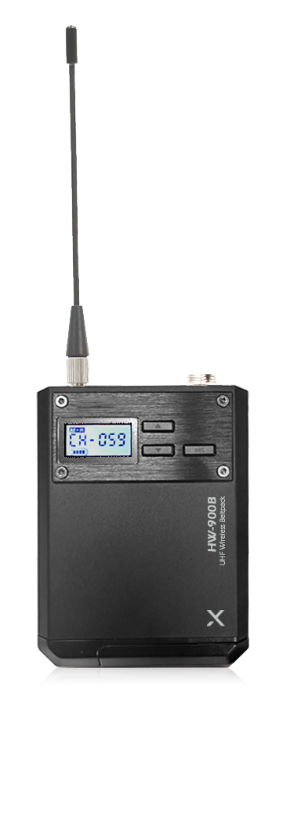

Wireless 1CH Receiver
HW-910
Professional Wireless MIC System
FEATURE
핸드마이크와 벨트팩 동시연결 스위칭 기능
스펙트럼 아날라이저 탑재
고품질 유닛 탑재
노이즈 제거 및 안정적 통신 유지
TFT LCD 디스플레이 탑재
SPECIFICATION
항목 | 수신기
Frequency range | 925.0 ~ 937.5MHz
Frequency stability | 0.002PPM
Receiving sensitivity | -100dB
Tone frequency response | 60hz-18kHz (3dB)
Harmonic distortion | < 0.5%
Signal to noise ratio | ＞105dB
Dynamic range | 105dB
Maximum frequency offset | ±48KHz
Stray suppression | ≥75dB
Audio output | Balanced and unbalanced output
Power supply | 12-18V DC/1000mA
Dimensions (W x H x D) | 210x45x160mm
Weight | 542g
항목 | 송신기
Frequency range | 925.5~937.25MHz
Output power | 5mW / 15mW
Spurious emission | < -70dBc
Bandwidth | 60MHz
Max modulation depth | ±48kHz
Frequency response | 60~15kHz
Signal to noise ratio | > 105dB
Distortion | < 0.5%
Input voltage range | mic 1V max
Power supply | 2 × 1.5V (AA)
Battery life | 10 hours
Dimensions (W x H x D) | Hand: 275(L)x48(Ø)mm, Beltpack: 64x84x21mm
Weight | Hand- 324g, Beltpack- 114g
www.voatek.com
e-mail : voatek@naver.com
Tel : 031-8011-0388

