Slide 1

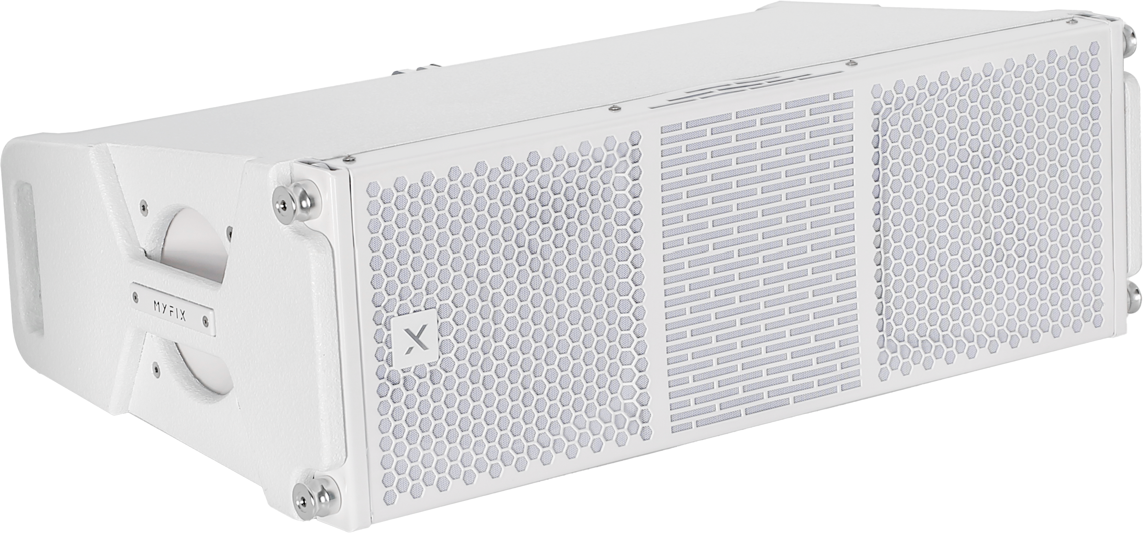
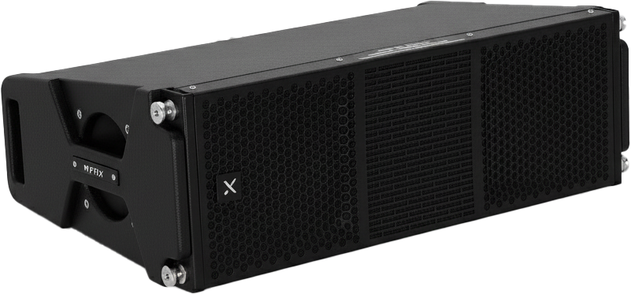

Line Array Speaker
LX-208
Professional Line Array Speaker System
FEATURE
듀얼 8” MF 네오디뮴 + 3” HF 네오디뮴 드라이버 구성
최대 140dB SPL의 높은 출력
공연장, 교회, 컨퍼런스 등 다양한 공간에 최적화
러시아산 벗지 우드로 제작하여 견고함
SPECIFICATION
항목 | 세부내용
Frequency Response | 80Hz – 19kHz (±5dB)
Transducer Configuration | MF: 2 × 8" (65mm voice coil neodymium drivers) HF: 1 × 3" (75mm voice coil neodymium driver)
Power Handling | MF: 600W (RMS) / 1200W (Program) HF: 100W (RMS) / 200W (Program)
Sensitivity (1W/1m) | 97dB
Maximum SPL | 140dB
Nominal Impedance | 8Ω
Coverage Angle (h × v) | 110° × 15°
Connector | 2 × NL4 Speakon
Enclosure Material | 15mm plywood with eco-friendly, wear-resistant black water-based paint
Dimensions (W × H × D) | 731 × 240 × 429mm
Weight | 23.3kg
경기도 성남시 분당구 판교로 723(분당테크노파크) B동 604-2호
TEL : 031-709-1061 / FAX : 031-709-1062
www.voatek.com
e-mail : voatek@naver.com
Tel : 031-8011-0388

