Slide 1

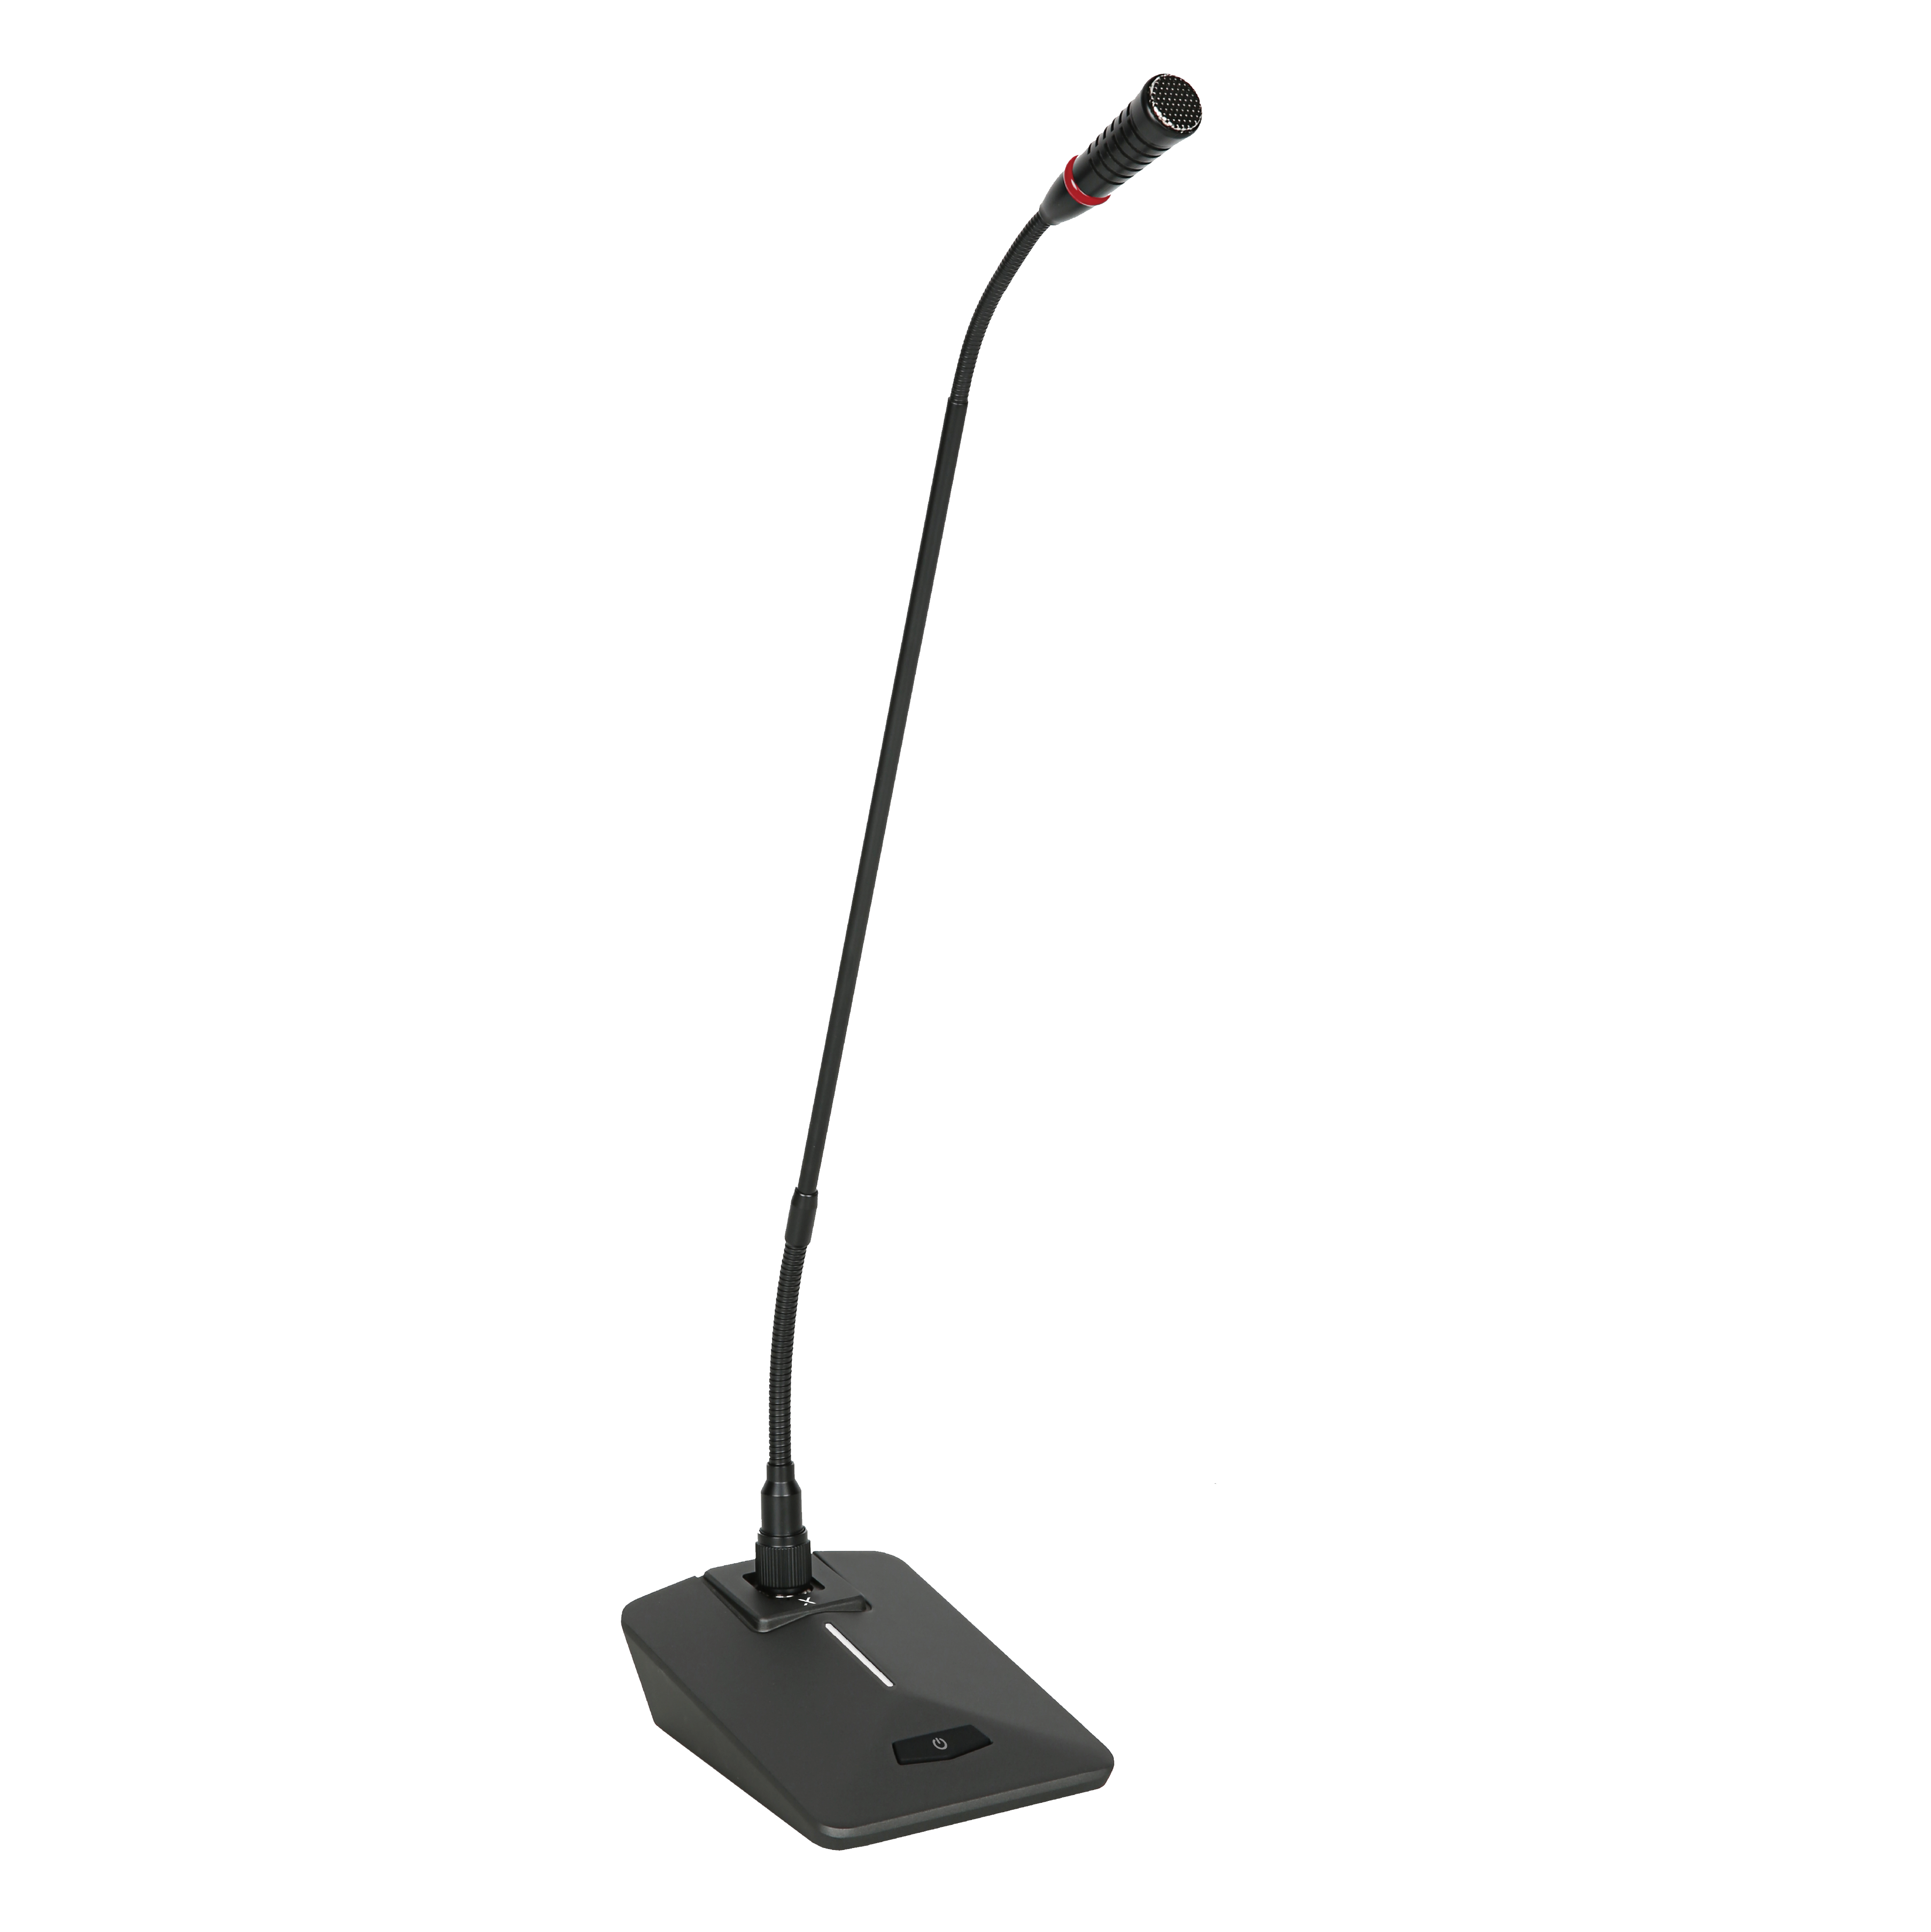

Gooseneck Microphone
MG-58
Professional Sound System
FEATURE
탁월한 수음력과 고음질, 하울링에 강한 안정성
깨끗하고 자연스러운 음질 전송
On/Off 전원 스위치로 손쉽게 음소거 기능 사용
SPECIFICATION
항목 | 세부내용
Microphone pattern | Unidirectional microphone
Frequency response | 60Hz~16KHz (-3dB)
Sensitivity | (-42dB) (-3dB) 1KHz
Low frequency attenuation | 125Hz 6dB/OCTAVE
Output impedance | 2500hms +30%
Maximum sound pressure | 135dB SPL 1KHz At1% T.H.D
S/N ratio | 66dB. 1KHz at 1Pa
Dynamic range | 111dB. 1KHz AT MAX SPL
Power supply | Phantom 48V
Output connector | three-pin Cannon
Base Dimensions (W × H × D) | 110 x 150 x 50 mm
Gooseneck length | 57.5cm
Weight | 580g
www.voatek.com
e-mail : voatek@naver.com
Tel : 031-8011-0388

