Slide 1

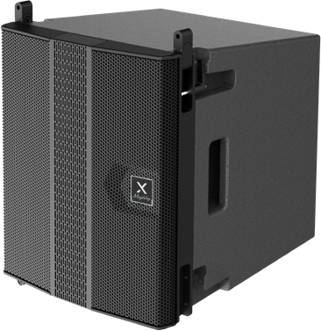

Active Line Array Speaker
Mighty6
Professional Active Line Array Speaker System
FEATURE
근거리 음질 이상을 방지하기 위한 동축 설계
미드레인지 간섭을 크게 줄이는 특수 도파관 기술
각 주파수 대역의 위상 일관성을 유지하는 고유한 FIR필터 기술
프리셋 4타입 설정
SPECIFICATION
항목 | 세부내용
Type | 2 way active vented design
Frequency Response | 65 ~ 20kHz
Maximum SPL | 132dB
Crossover Point | 630Hz
Sensitivity input Selectable | +3dBV, 0dBV, -3dBV, -6dBV
Driver LF | 6 x 4.2" woofer + 6 x 2" full range line array
Dispersion Angle (H x V) | H 120˚ x V 10˚
Signal Connectors (I/O) | Input : XLR | Output : XLR link
Power I/O | POWERCON
Volume | Volume control
Amplifier | Class-D
Power output (RMS) | LF: 500W + HF: 500W TOTAL 1000W
Power output (MAX) | LF: 1000W + HF: 1000W TOTAL 2000W
Feature functions | DSP Setup, Switching power design, LED power / signal / clip indicator, FIR filter design, flat phase curve
Cabinet | Birch Plywood with polyurea painted finish
Pole support | Double holes 35mm Steel bottom holder
Rigging and handling | Inter-enclosure angles 0,1,2,3,4,6,8,10˚
Fuse | T4AL 250V
Operating voltage | AC 220V-240V, ~50/60Hz
Dimensions (H x W x D) | 367 x 315 x 402mm
Net Weight | 13.6kgs
www.voatek.com
e-mail : voatek@naver.com
Tel : 031-8011-0388

