Slide 1

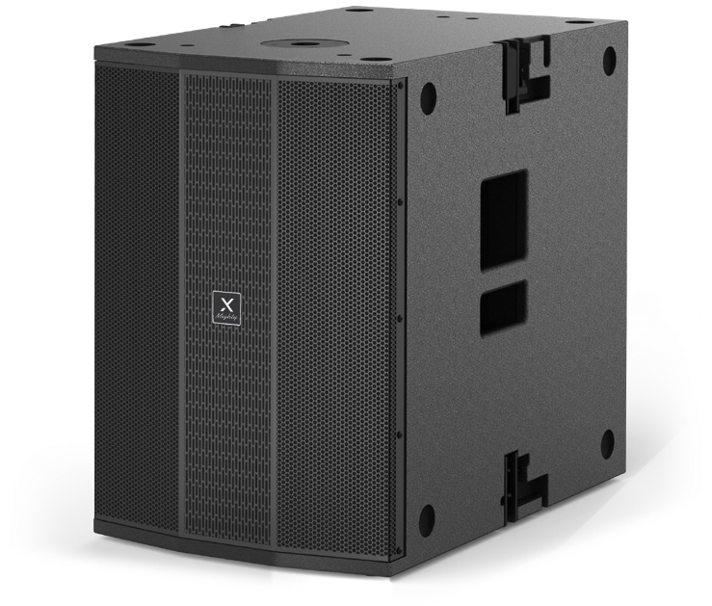

Active Line Array Subwoofer Speaker
Mighty6 Sub
Professional Active Line Array Speaker System
FEATURE
LCD 디스플레이 화면을 통해 모든 파라미터 직접 제어 가능
프리셋 설정 포함
SPECIFICATION
항목 | 세부내용
Type | Active vented subwoofer
Frequency Response | 40 ~ 120Hz
Maximum SPL | 134dB
Crossover Point | Selectable 100Hz, 120Hz
Driver LF | 15" subwoofer, 3" Voice Coil
Signal Connectors (I/O) | Input : 2 x XLR | Output : 2 x XLR link
Power I/O | POWERCON
Volume | Volume control
Amplifier | Class-D
Power output (RMS) | 1000W
Power output (MAX) | 2000W
Feature functions | LCD with multiple DSP, Switching power design LED power / signal / clip indicator, Phase switchable (0/180) Delay value adjust, 100ms max
Cabinet | Birch Plywood with polyurea painted finish
Grille | 1.5mm steel
Pole support | M20 screw pole
Rigging and handling | Inter-enclosure angles 0˚ (Stacking)
Flybar support | T6.35AL 250V
Operating voltage | AC 220V-240V, ~50/60Hz
Dimensions (H x W x D) | 623 x 443 x 660mm
Net Weight | 37.5kgs
www.voatek.com
e-mail : voatek@naver.com
Tel : 031-8011-0388

