Slide 1

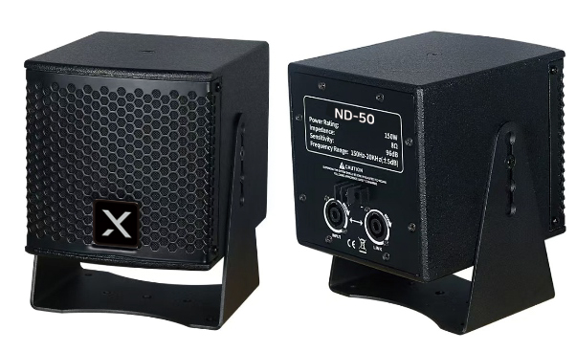

Coaxial Compact Speaker
ND-50
Professional Full Range Speaker System
FEATURE
125Hz~20kHz의 넓은 주파수 응답
최대 120dB 출력
5인치의 컴팩트한 사이즈의 다용도 스피커
U브라켓으로 다양한 설치 옵션
SPECIFICATION
항목 | 세부내용
Frequency Response | 125Hz – 20kHz (±5dB)
Transducer Configuration | MF: 1 × 5" (35mm voice coil) HF: 1 × 1" (25mm voice coil)
Power Handling | MF: 100W (RMS) / 200W (Program) HF: 30W (RMS) / 60W (Program)
Sensitivity (1W/1m) | 96dB
Maximum SPL | 120dB
Nominal Impedance | 8Ω
Coverage Angle | 90° (H) × 60° (V)
Connector | 2 × NL4 Speakon
Enclosure Material | 12mm plywood, Environmental Protection wear resistant black water-based paint
Dimensions (W × H × D) | 155 × 155 × 180 mm
Weight | 4.4kg
www.voatek.com
e-mail : voatek@naver.com
Tel : 031-8011-0388

