Slide 1

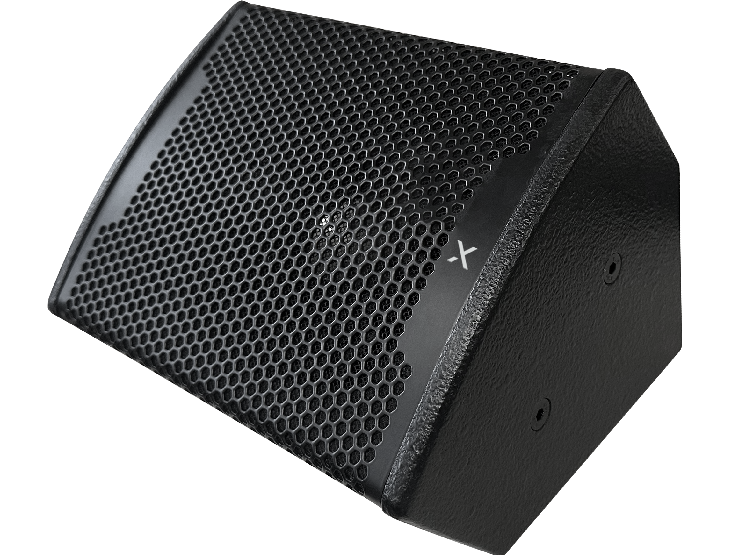

Coaxial Multipurpose Speaker
ND-65
Professional Full Range Speaker System
FEATURE
90Hz~20kHz의 넓은 주파수 응답
최대 122dB 출력
6.5인치의 컴팩트한 사이즈의 다용도 스피커
U브라켓으로 다양한 설치 옵션
SPECIFICATION
항목 | 세부내용
Frequency Response | 95Hz – 20kHz
Driver | MF: 1×6.5" (130 magnetic Φ50mm), HF: 1×1.38" (Φ38mm)
Rated Impedance | 8Ω
Sensitivity | 96dB
Rated Power | 180W
Peak Power | 360W
Maximum SPL | 122dB
Diffusion Angle | 110° × 50° (H × V)
Crossover Mode | Internal/external crossover
Installation | Special U-shaped frame/hang up/support
Product Size (W × H × D) | 267 x 207 x 191mm
Weight | 5.3kg
www.voatek.com
e-mail : voatek@naver.com
Tel : 031-8011-0388

