Slide 1

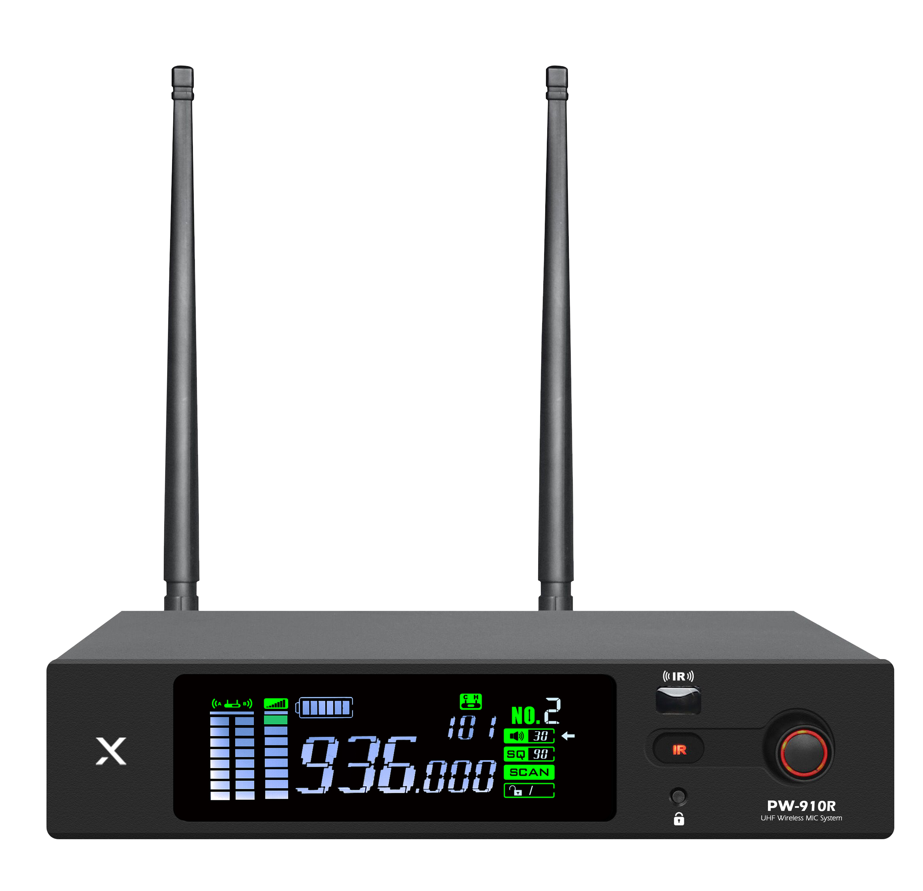

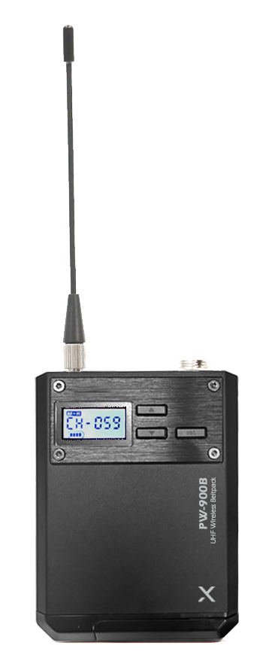

Wireless 1CH Receiver
PW-910
Professional Wireless MIC System
FEATURE
UHF 1채널 무선 시스템
PLL 자동 채널 IR 방식
고품질 유닛 탑재
노이즈 제거 및 안정적 통신 유지
SPECIFICATION
항목 | 수신기
Carrier frequency band | 925.0 ~ 937.5MHz
Oscillation mode | DPLL digital phase-locked loop technology
Bandwidth | 50MHz
Frequency response | 50Hz～17kHz
Receiving sensitivity | When the offset is 35 kHz and the input is 6 dBµV, S/N ≥ 58 dB.
Frequency stability | 0.01%
Audio frequency offset | 75 kHz offset at < 1% distortion
Comprehensive signal-to-noise ratio | S/N ≥ 95 dB
Comprehensive T.H.D | < 0.7% @ 1 kHz
Balanced output port | Impedance 680 ohms,
Unbalanced output audio port | Impedance 2200 ohms
Effective working distance | 100 meters (open place)
Power supply | DC 12V-1000mA.
항목 | 송신기
Carrier frequency band | 925.0 ~ 937.5MHz
Modulation mode | Broadband FM
Oscillation mode | DPLL digital phase-locked loop technology
Harmonic radiation | More than 45 dB below the carrier
Radio frequency power | 5 mW (low), 25 mW (high)
Audio frequency offset | 75 kHz offset at < 1% distortion
Frequency response | 50 Hz – 17 kHz (±3 dB)
Tone mode | Moving coil microphone
Current consumption | 130mA
Battery life | Approx. 10 hours
Battery | 2 × AA batteries (1.5 V each)
www.voatek.com
e-mail : voatek@naver.com
Tel : 031-8011-0388

