Slide 1

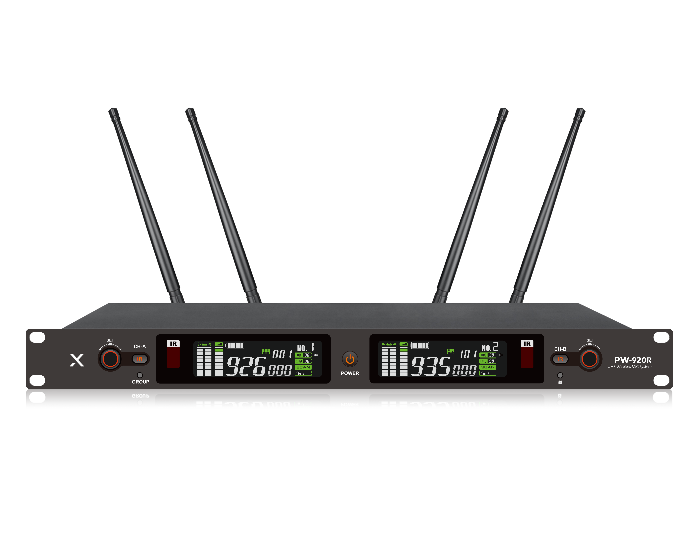
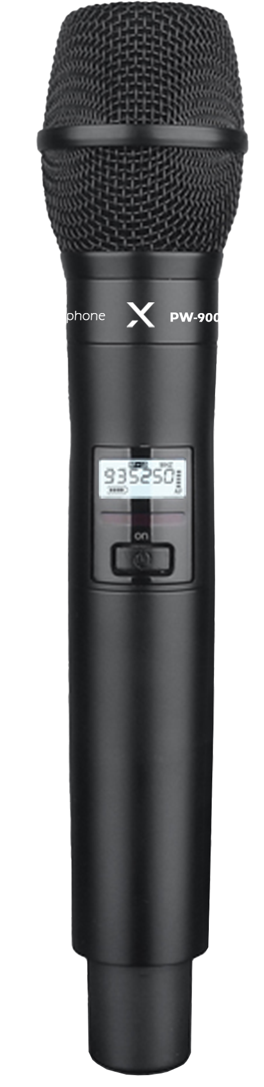
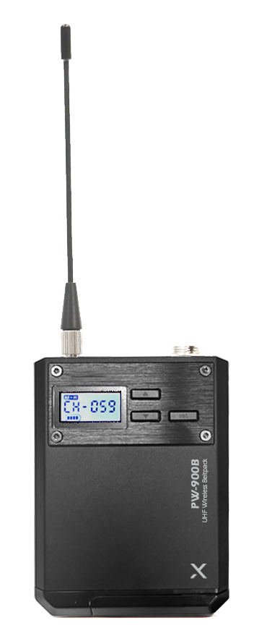

2CH Wireless Mic System
PW-920
Professional Wireless MIC System
FEATURE
UHF 2채널 무선 시스템
PLL 자동 채널 IR 방식
고품질 유닛 탑재
노이즈 제거 및 안정적 통신 유지
SPECIFICATION
수신기(PW-920R) | 세부내용
Carrier frequency band | 925.0 ~ 937.5MHz
Oscillation mode | DPLL digital phase-locked loop technology
Bandwidth | 50MHZ
Frequency response | 50Hz～17KHz
Receiving sensitivity | when the offset is equal to 35KHZ, When 6dBuV is input, S/N>58dB.
Frequency stability | 0.01%
Audio frequency offset | 75KHz@ distortion < 1%
Comprehensive signal-to-noise ratio | S/N>95dB.
Comprehensive T.H.D: | <0.7%@1KHz
Frequency response | 50Hz～17KHz
Balanced output port | impedance 680 ohms,
Unbalanced output audio port | impedance 2200 ohms
Effective working distance | 100 meters (open place)
Power supply | DC 12V-1000mA.
Size (WxDxH) | 482*44*180mm
송신기 (PW-900D) | 세부내용
Carrier frequency band | 925.0 ~ 937.5MHz
Modulation mode | broadband FM
Oscillation mode | DPLL digital phase-locked loop technology
Harmonic radiation | more than 45dBm lower than the main wave.
Radio frequency power | low power 5mW, high power 25mW.
Audio frequency offset | 75KHz@ distortion < 1%
Frequency response | 50Hz～17KHz±3dBm
Tone mode | moving coil microphone
Current consumption | 130mA
Battery life | ≧ 10h
Battery | AA*2(1.5V)
Size (WxDxH) | 257*50mm
www.voatek.com
e-mail : voatek@naver.com
Tel : 031-8011-0388

