Slide 1


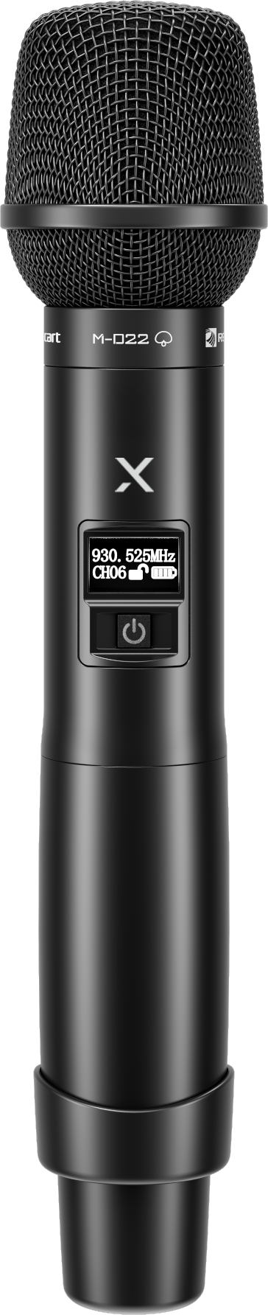
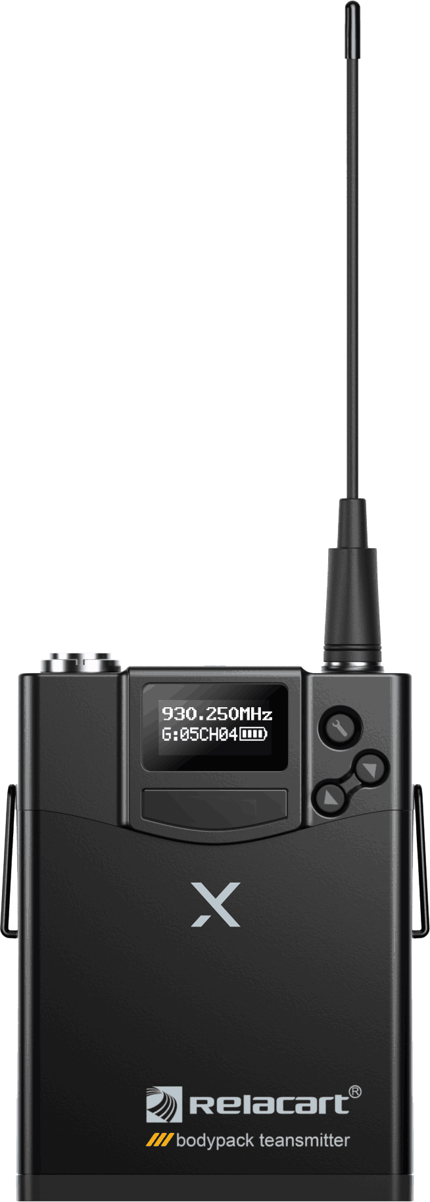
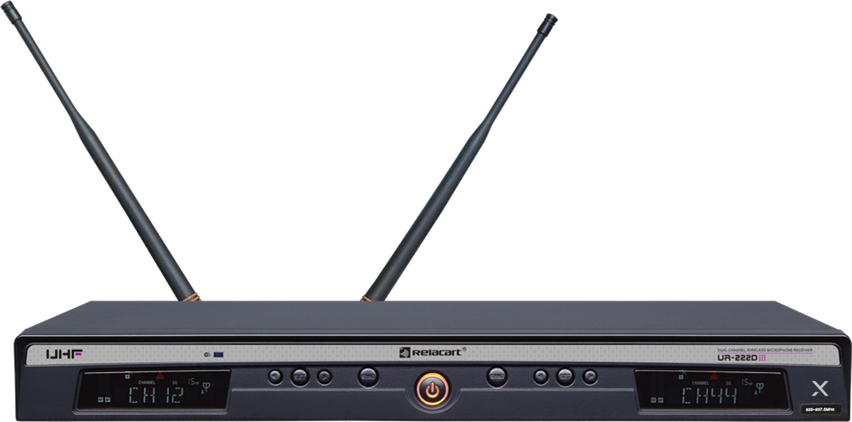

Wireless 2CH Receiver
x
UR-222D
X
Professional Wireless MIC System
FEATURE
900MHz에서 안정적으로 12채널 이상 동시 사용
Pilot 기능으로 간섭, 신호 혼선 방지
AFS버튼으로 주파수 자동 검색
88개 주파수 채널
LCD로 RF/AF·배터리 상태 확인
SPECIFICATION
항목 | 수신기 UR-222D
Carrier Frequency Range | 925MHz ~ 937.5MHz
Modulation Mode | FM
Oscillation | PLL synthesized
Sensitivity | S/N > 60dB at 25 deviation
Bandwidth | 12.5MHz
S/N | >105dB
T.H.D | <0.7% @1KHz
Frequency Response | 80Hz ~ 18KHz ±3dB
Operating Range | 80M typical (in open space)
Dimension (mm) | 410 (W) × 206 (D) × 44 (H)
Weight | Approximately 1.9kg
항목 | 송신기 Hand : UH-222, Bodypack : UT-222
Harmonic Radiation | <45dBm
Bandwidth | 134MHz (It depends on the region)
Max. Deviation Range | ±45KHz
Microphone Element | Dynamic
RF Output Power | 10mW/40mW
Battery | AA × 2
Current Consumption | 110mA (Typical)
Battery Current/Life | Approximately 11 hours
Dimension (mm) | Hand : 52 (Ø) × 255 (L) Bodypack : 84 (H) × 66 (W) × 23 (D)
Weight | Hadn : 235g Bodypack : 155g
www.voatek.com
e-mail : voatek@naver.com
Tel : 031-8011-0388

