Slide 1

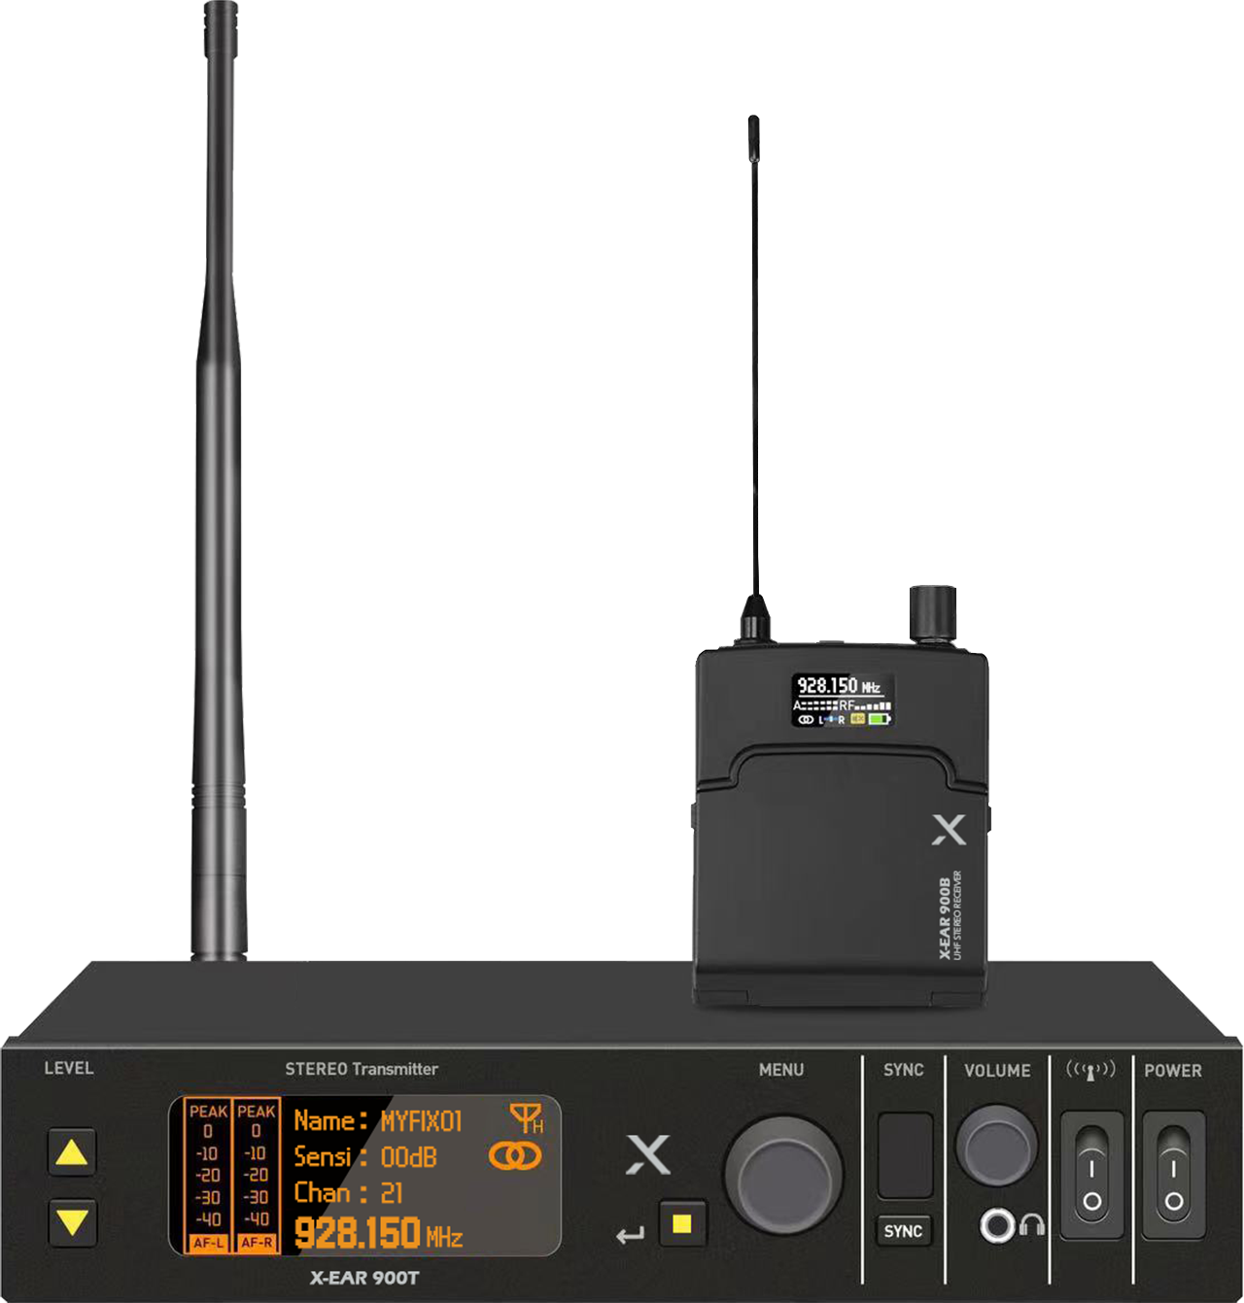

Stereo In-Ear Monitoring System
X-EAR
Professional Wireless MIC System
FEATURE
PLL UHF 무선 스테레오 전송으로 고음질 모니터링
60m 거리에서 안정적으로 무선 연결
DSP 디지털 오디오는 48KHz 샘플링 속도로 노이즈 최소화
모노 모드에서 L,R을 분리하여 두 개의 벨트팩에 분리된 L,R 신호 모니터링 가능
SPECIFICATION
항목 | X-EAR 900T (송신기)
Carrier frequency range | 925MHz-937.5MHz
Oscillation mode | PLL frequency synthesis
RF out power | 13.5dBm
Carrier error | 0.01%
Harmonic radiation | -32dBm
Modulation | FSK
Nominal/maximum frequency deviation | ±65KHz
Stereo input interface | phone Φ6.3mm*2, XLR composite*2
Input impedance | 2.2KΩ
Input gain range | 36 adjustable settings by every 1dB step
Power supply | DC 12V/1A
Working current | 350mA
Dimensions | 210 * 44 * 150mm
Net weight | 526 g
항목 | X-EAR 900B (수신기)
Carrier frequency range | 925MHz-937.5MHz
Receiving mode | Superheterodyne
Image suppression | 45dBm
RF sensitivity | when input is 10dBu, S/N ≥45dB
SQ adjustment | built-in setting parameters
Headphone output power | 80mW@16Ω
Output level adjustment range | 30 levels adjustable, attenuation adjustment at every 1dB step
Power requirement | AA1.5 batteries *2
Working current | 3V 160mA
Battery life | ≥6 hours
Dimensions | 77.5 * 63 * 19.5mm
Net weight(without battery) | 66.8g
www.voatek.com
e-mail : voatek@naver.com
Tel : 031-8011-0388

